Slide 1

Optimizing the Egyptian Premier League Schedule
A Mathematical Optimization Approach using Integer Linear Programming

Slide 2
Table of contents
01
Introduction
02
Background
03
Project Data
04
Mathematical Model
05
Solution Methodology
06
Insights &Visualization
07
User Interface
08
Conclusion & Future Work
03
The school’s teachers

Slide 3
01
INTRODUCTION
Introduction To The Project And Problem Overview

Slide 4
The origin of the story
For years, league scheduling relied on manual planning, quietly accumulating issues that became impossible to ignore during Egypt’s emergency hosting of AFCON 2019.
This trapped the league in a "Domino Effect" which results in:
Fixture Congestion: Teams facing impossible turnaround time
Uneven Rest: Disparities in recovery time between competing clubs.
Frequent Postponements: A chaotic schedule that changes frequently.

Slide 5
Our Goal
Structured Framework: Model the league using Integer Linear Programming (ILP) / CP-SAT.
Time Management: Fit the standard 34-round season strictly between August and May.
Constraint Satisfaction: Respect CAF commitments, Security refusals, and FIFA breaks.
Fairness: Balance Home/Away streaks and travel distances.

Slide 6
02
BACKGROUND
Background And Existing Work

Slide 7
Sports Scheduling as an Optimization Problem
Sports scheduling is a subfield of Operations Research and Combinatorial Optimization
NP-hard problem
DRR format
In the EPL:
Complexity grows exponentially with:
number of teams
number of constraints
Standard football leagues follow a Double Round Robin
Each team plays every other team twice (home & away)
For n teams → n(n−1) total matches
Egyptian Premier League has:
18 teams
306 matches
34 rounds

Slide 8
Fairness & Travel
Patterns & Breaks
Travel & TTP
Pattern is a sequence of Home (H) and Away (A) matches
Break = H–H or A–A
Away breaks = unfair & exhausting
Perfect alternation (H–A–H–A) for all teams is mathematically impossible
Traveling Tournament Problem (TTP) :
Introduced to minimize total travel distance
Especially important in geographically spread leagues
Travel fatigue directly affects performance and recovery

Slide 9
The Egyptian Gap
Why can't we just copy?
Security Approvals
CAF Conflict
Shared Resources
Specific match-ups are banned in specific cities
Al Ahly & Zamalek schedules are fluid, breaking standard mathematical patterns.
Multiple teams share "Cairo International" and "Borg Al-Arab," creating bottlenecks

Slide 10
03
PROJECT DATA
Data And Preprocessing

Slide 11
Data Collection
Sources: Automated Web Scraping to ensure real-time accuracy and consistency Integration: Exported data into spreadsheets for data processing
Historical Benchmarking: Collected past season data to measure improvements and efficiency.

Slide 12
Data Architecture
Teams
Stadiums
Calendar
Administrative details & Home venues
Locations, Capacities & Floodlight availability
Every available "Slot" (Date + Time)
Security Matrix
Distance Matrix
Forced Venues
Continental Blockers
KM distance between every 2 nodes
CAF days & Travel Buffers , FIFA Days

Slide 13
04
MATHEMATICAL MODEL
Sets, Variables, Constraints & Objective Function

Slide 14
Sets & Parameters
M — all matches, |M| = 306
S — usable calendar slots, |S| ≈ 824
T — teams, |T| = 18
V — stadiums, |V| = 22
R — rounds {1 … 34}
C ⊆ T — CAF-participating teams
T1 ⊆ T — Tier-1 teams
W, D — calendar weeks / dates
tier_match(m), round(m), is_derby(m)
tier_slot(s), time_index(s), kickoff_hour(s)
nominal_week(r) — ideal week per round
caf_dates(t), CAF_BUFFER = 4 days
MAX_DAY = 3, MAX_SLOT = 2
REST_LOCAL = 4 days, MAX_STREAK = 2
Weekly load: hard 18 · soft band 6–12

Slide 15
DECISION VARIABLES
Round Min / Max
Primary Assignment
Auxiliary Time Variables
xm,s,v ∈ {0,1}
match_timem, match_datem ∈ ℤ⁺
round_minr, round_maxr ∈ ℤ⁺
Weekly Load Variables
Final-Round & Collision Indicators
load_w, under_load_w, over_load_w ∈ ℤ⁺
fr_slots, slot_collisionss, overlapv,d ∈ {0,1}

Slide 16
HARD CONSTRAINTS
Every match gets exactly one slot; venues host ≤1 match per slot; ≤3 matches/day; ≤2 matches share a kickoff slot.
Assignment & Capacity
H1, H4, H5, H6
Each team plays ≤1 match per day; ≥3 full rest days between matches (4-day sliding window); ≤2 consecutive home/away streak.
Rest & Fairness
H3, H7, H13
Chronology & Load
match_time/date defined per slot; round r fully finishes before round r+1 starts; ≤18 matches per calendar week.
H8, H9, H10, H11
Derby & Final Round
Tier-1 vs Tier-1 matches forced into Tier-1 (prime-time) slots; all 9 Round-34 matches share one kickoff slot and one date.
H2, H14
CAF Buffer
Matches for CAF-participating teams excluded from any slot within 4 calendar days (before or after) of that team's CAF fixture.
H12

Slide 17











Objective Function
Normalized Additive Utility Function: U(X) = Σ (w_i * f_i(X) / N_i)
w_i : AHP Decimal Weight (sum to 1.0) N_i : Normalization Constant
Objective (f_i)
Normalization Constant (N_i)
Physical Unit
Stadium Maintenance Overlaps
$$N_{overlap}=10$$
Occurrences
Alt Venue Relief
$$N_{alt}=100$$
Occurrences
Other Venue Relief
$$N_{other}=50$$
Occurrences
Round Order Deviation
$$N_{round}=200$$
Weeks
Venue Displacement
$$N_{disp}=5,000$$
Kilometers
Weekly Underload
$$N_{under}=50$$
Matches
Weekly Overload
$$N_{over}=50$$
Matches
Away Travel Distance
$$N_{travel}=50,000$$
Kilometers
Tier Mismatch
$$N_{tier}=300$$
Tier levels
Evening Kickoff Preference
$$N_{evening}=200$$
Hours
Slot Spread Collisions
$$N_{spread}=50$$
Occurrences

Slide 18
Weight Determination (AHP)
Analytic Hierarchy Process (AHP) Framework
Replaces subjective hardcoded integers with dynamic decimal weights (sum = 1.0).
Decision Maker uses a 10-slider UI to compare 5 High-Level Criteria:
1. Venue Rest & Integrity (VR)
2. Travel Efficiency (TE)
3. Round Chronology (RC)
4. Weekly Balance (WB)
5. Broadcasting & Slot Quality (BQ)
Interactive Consistency Advisor ensures comparisons are mathematically valid (CR < 0.10).
Solver Integerization: Decimal weights are scaled by 100,000 to function in CP-SAT.

Slide 19
05
SOLUTION METHODOLOGY
CP-SAT Pipeline Architecture & Phase Flow

Slide 20
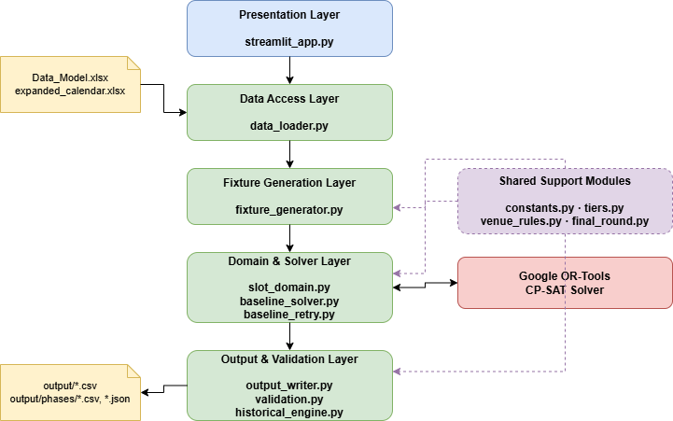
Component Diagram

Slide 21
Technology Stack
Language: Python 3
Optimizer: Google OR-Tools CP-SAT (Constraint Programming with Boolean Satisfiability)
Data I/O: Pandas + openpyxl for Excel workbook loading & CSV output
Frontend: Streamlit interactive web dashboard
Solver Config: 600s baseline time limit, 8 parallel worker threads

Slide 22
06
INSIGHTS & VISUALIZATION
Key Findings, Graphs & Dashboard Analytics

Slide 23
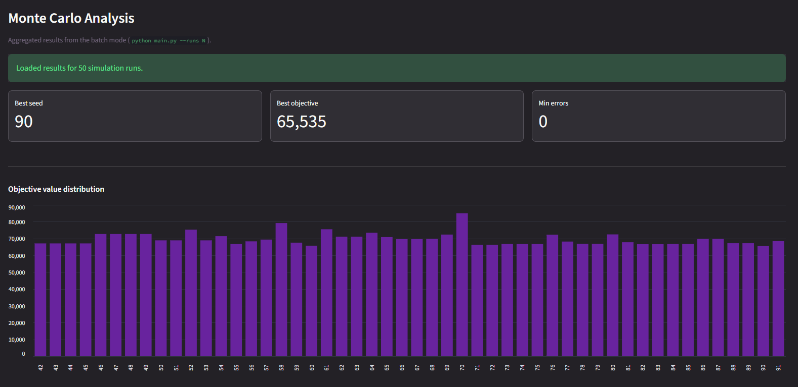
Monte Carlo Analysis
Selection criteria (in priority order):
Fewest validation errors, Lowest baseline objective value , Lowest total travel distance

Slide 24
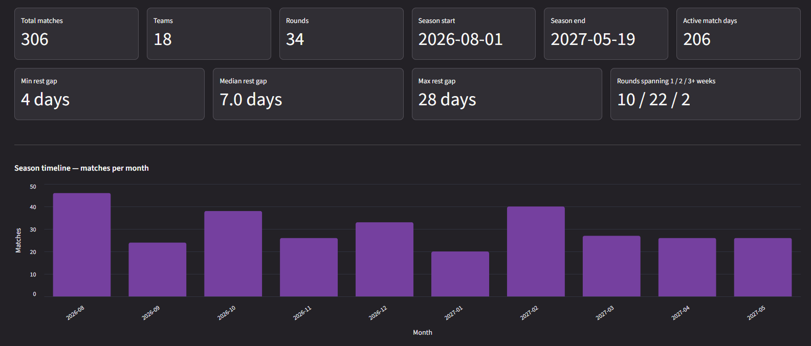
Schedule Insights

Slide 25
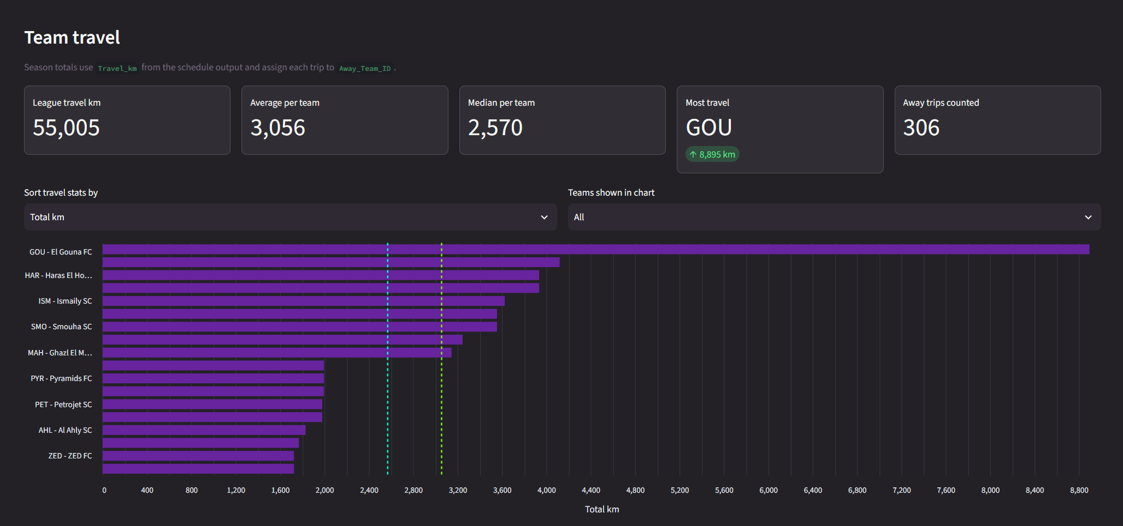
Travel Distance Analysis

Slide 26
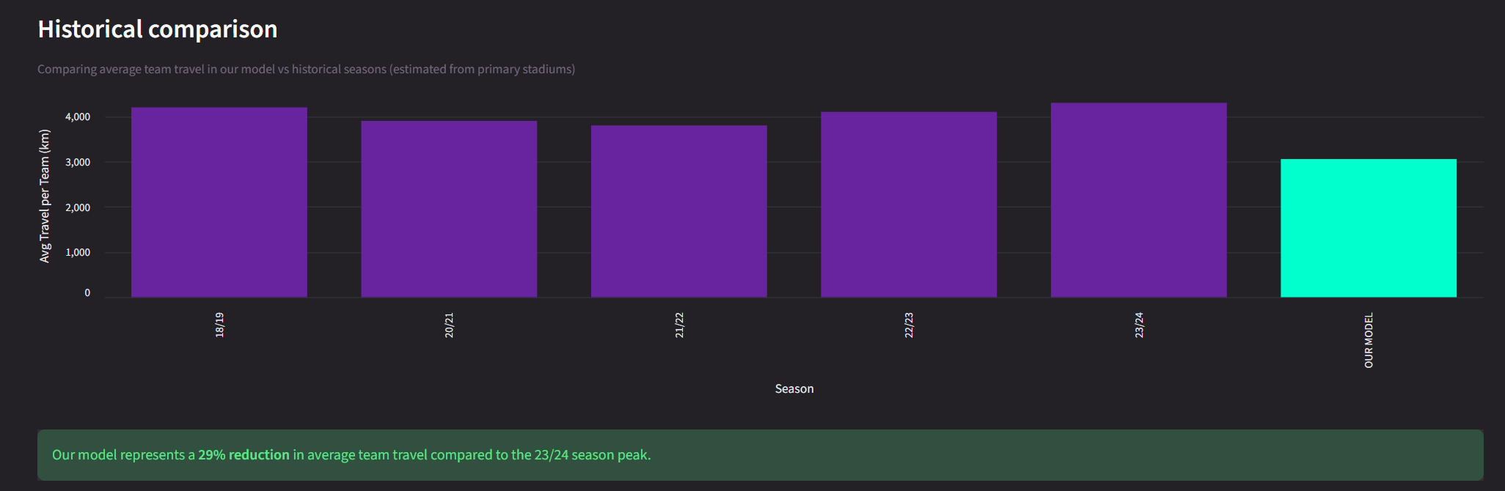
Travel Distance Analysis

Slide 27
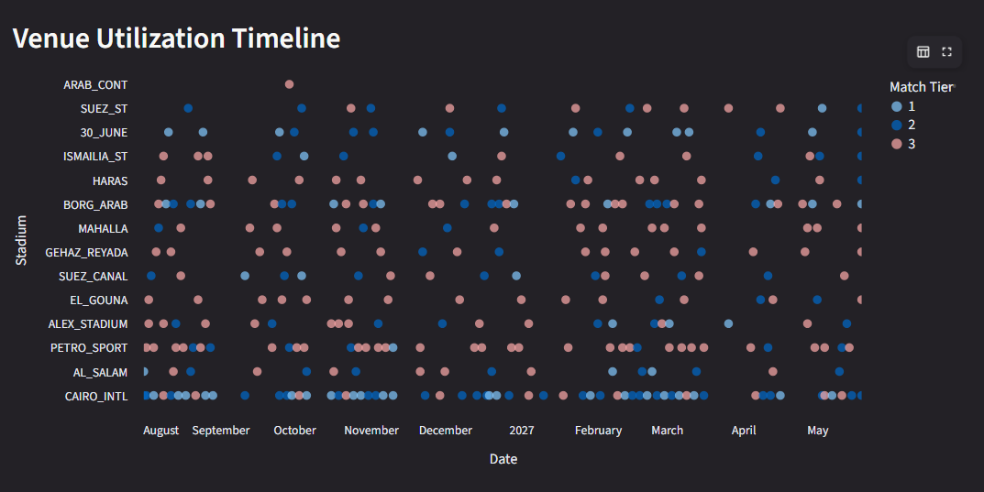
Stadiums & Venues

Slide 28
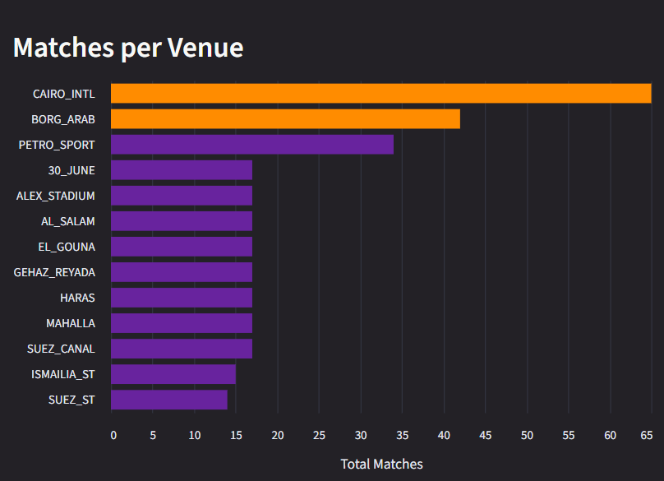
Stadiums & Venues

Slide 29
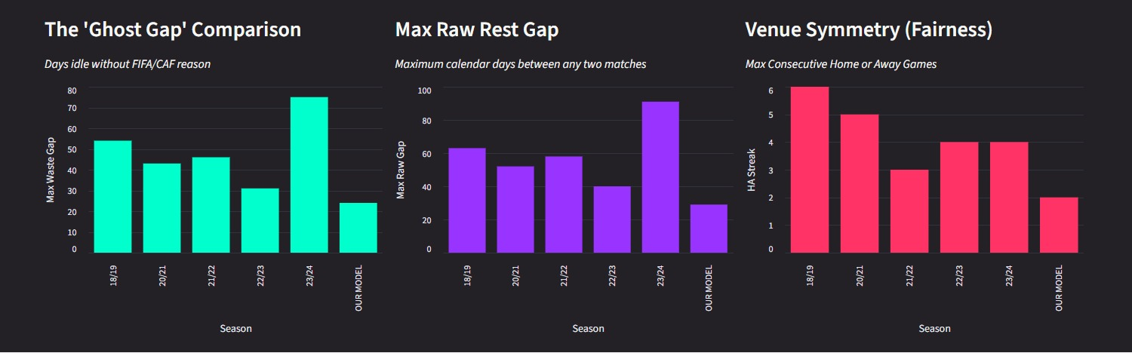
Historical Benchmarking
• 5 past seasons analyzed: 2018-19, 2020-21, 2021-22, 2022-23, 2023-24

Slide 30
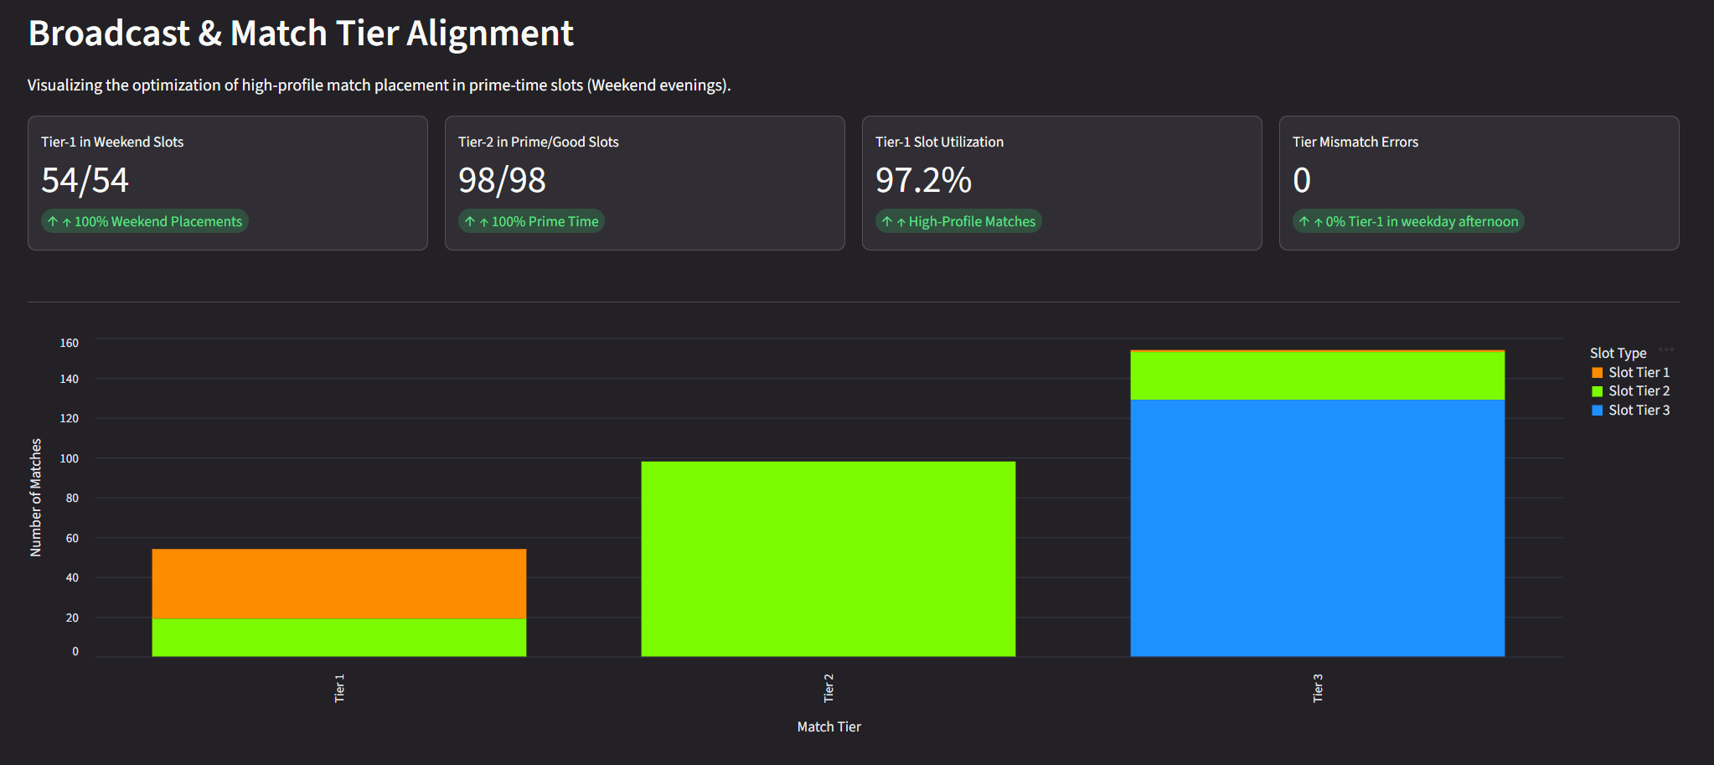
Broadcast & Match Tier Alignment
• 5 past seasons analyzed: 2018-19, 2020-21, 2021-22, 2022-23, 2023-24

Slide 31
07
USER INTERFACE
Streamlit Operational UI Demo

Slide 32
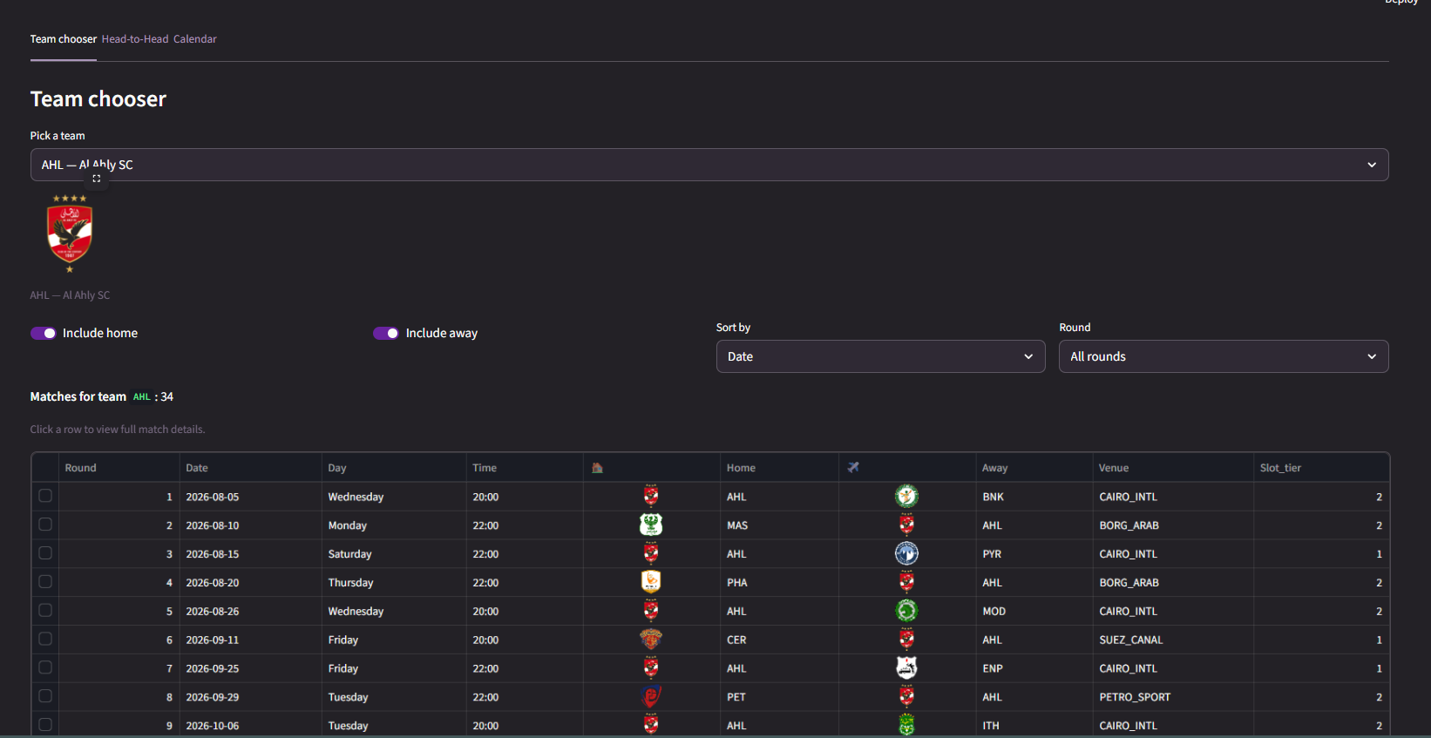
Dashboard Screenshots

Slide 33
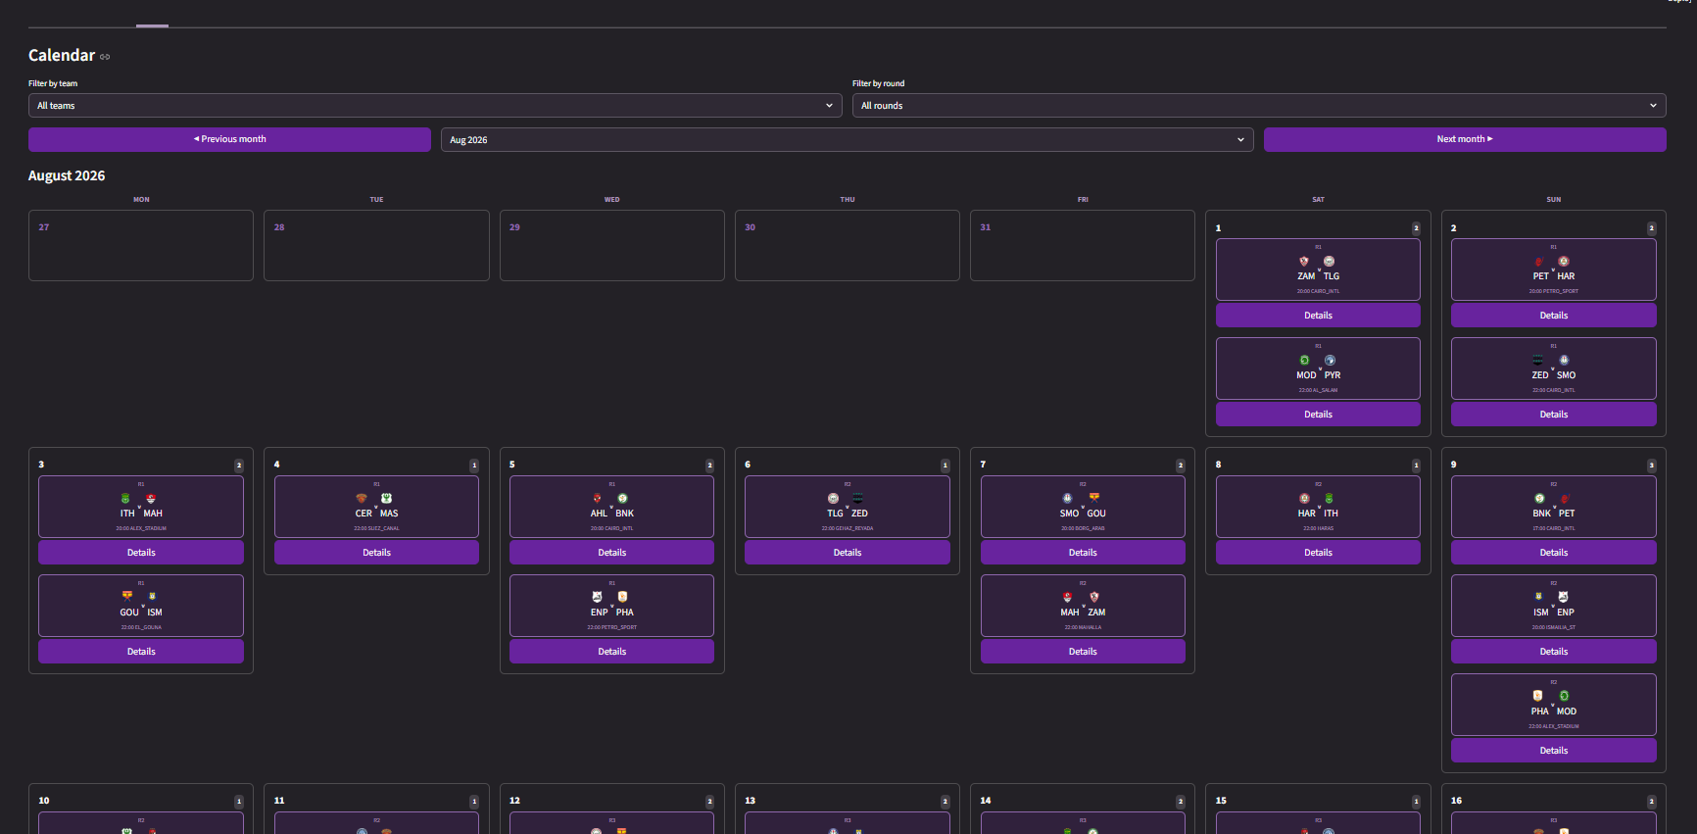
Dashboard Screenshots

Slide 34
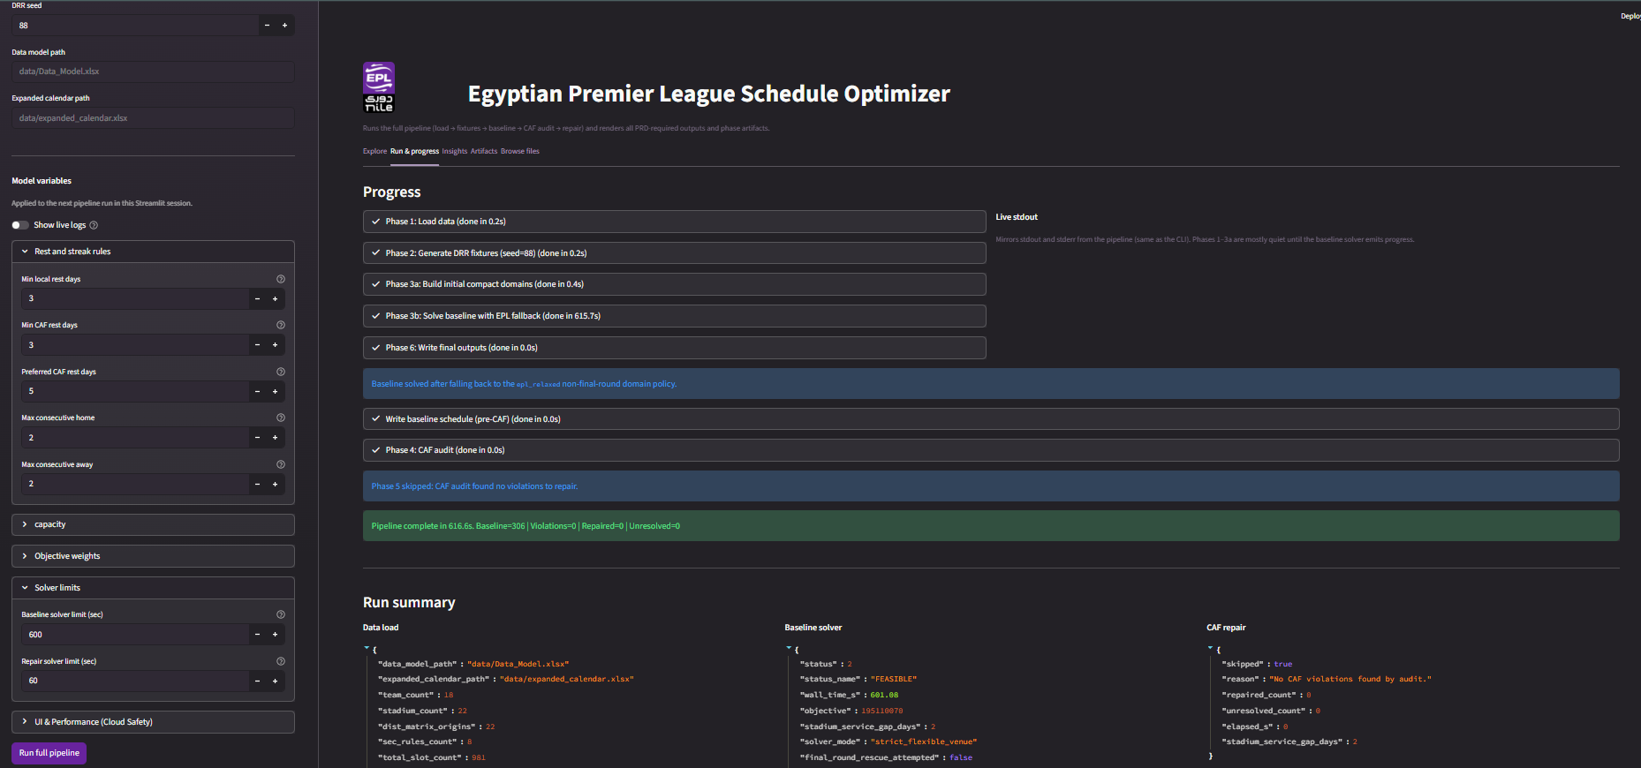
Dashboard Screenshots

Slide 35
08
CONCLUSION & FUTURE WORK
Key Achievements & Future Directions

Slide 36
Key Achievements
First-ever automated optimization of the Egyptian Premier League schedule.
306 matches assigned with ZERO constraint violations.
CP-SAT solver finds feasible solution in ~600 seconds
All 11 validation checks PASS
Interactive Streamlit dashboard for full operational control
Historical benchmarking shows improvement over past manual scheduling

Slide 37
Future Work
API Layer
League-agnostic configuration
Weather & Ramadan awareness
Sensitivity analysis
Metaheuristic hybridization

Slide 38


Thank You
Any Questions ?

Slide 39


Presented by
Name | ID
Rawan Ehab | 20220133
Mohamed Osama | 20220477
Ibrahim Medhat | 20221003
Ghassan Tarek | 20220239
Abdelrahman Ashraf | 20220189
Under Supervision of Dr. Sally Kassem
Eng. Rawaa Hesham

